Slide 1



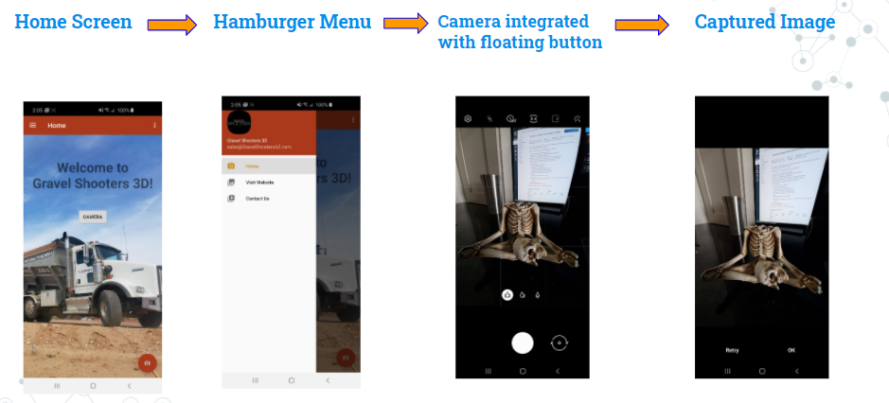
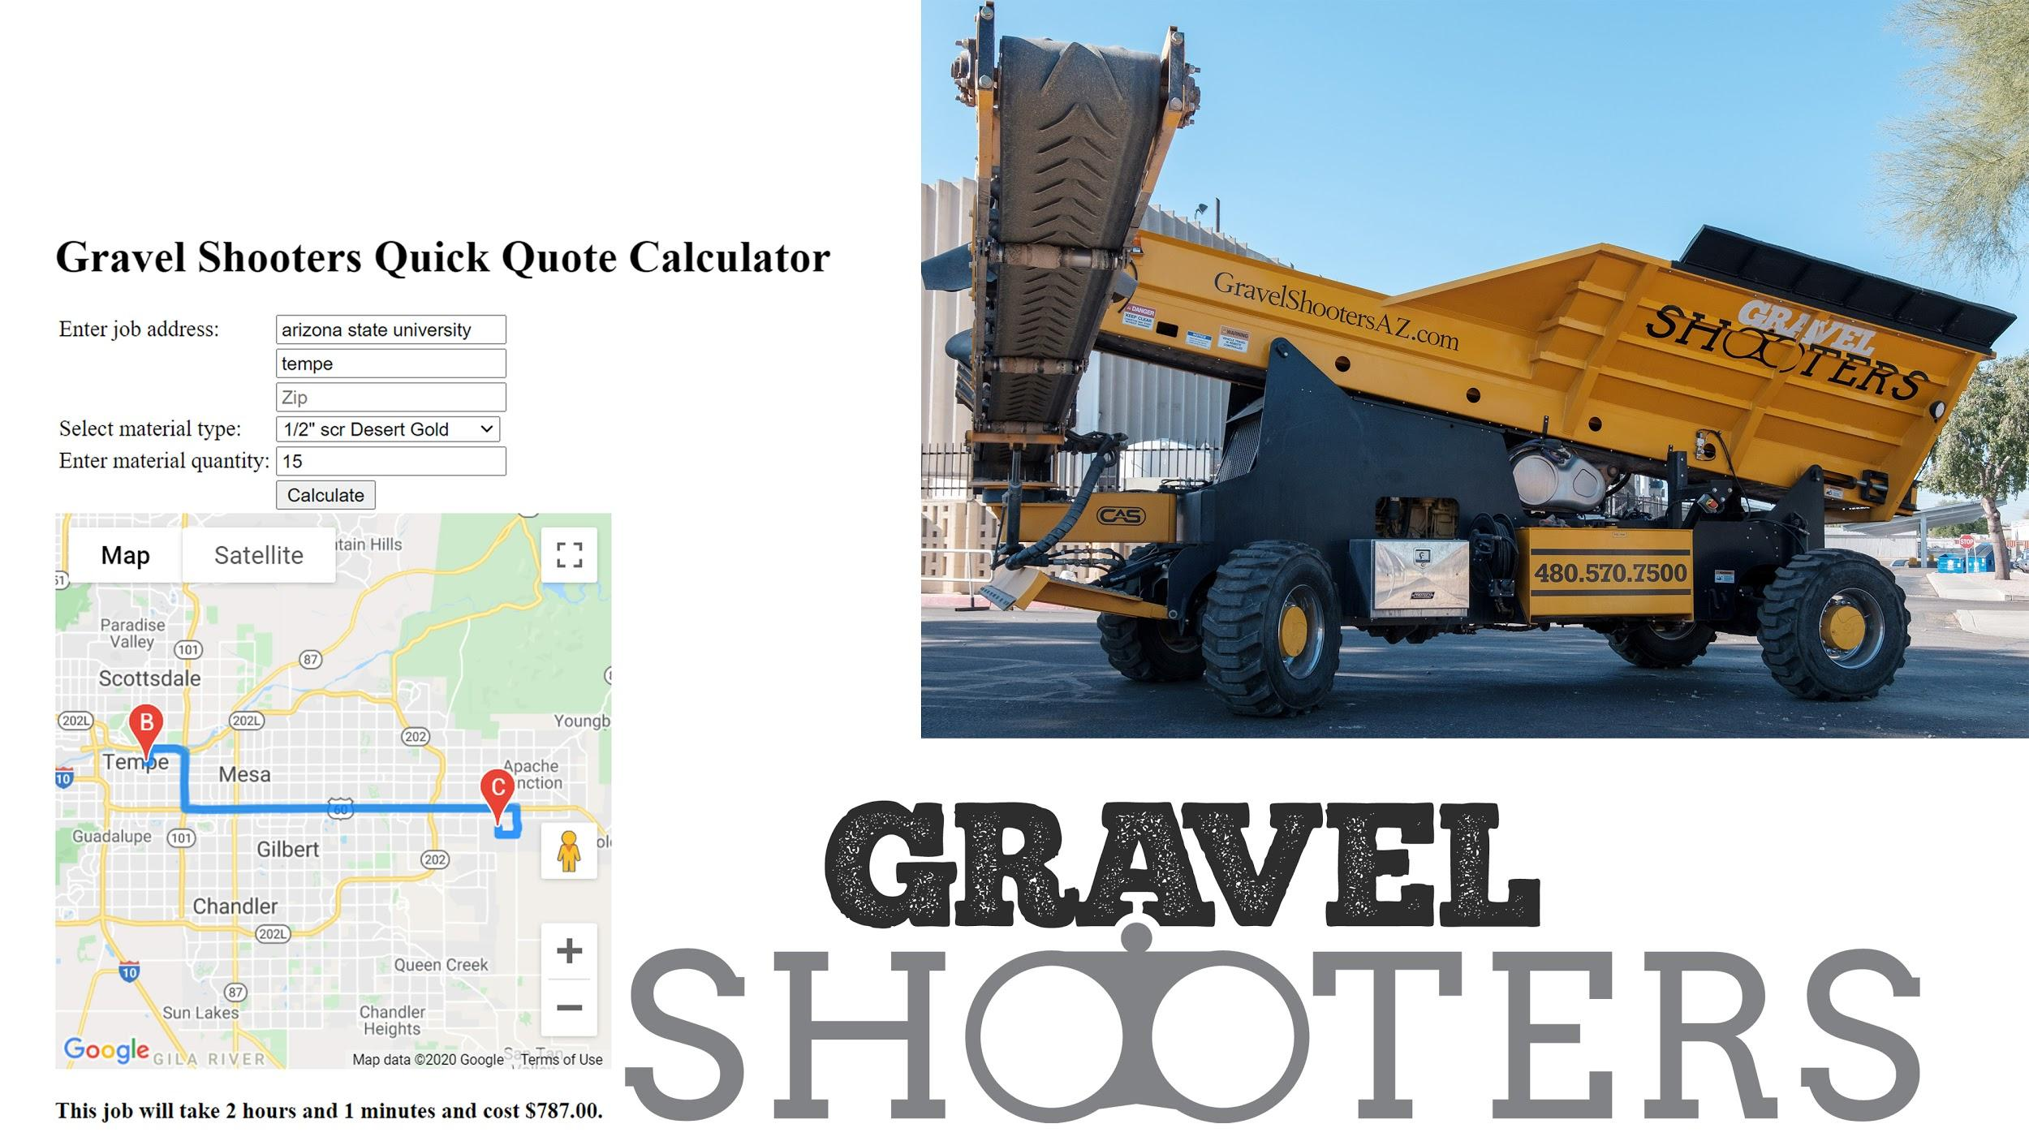
Gravel Shooters Local Business: Mobile App
PROJECT REQUIREMENTS
Gravel Shooters is a gravel delivery company in Phoenix, AZ who wants to serve its customers with a mobile app to aid in the process of gravel selection and purchase, give them a price quote and serve marketing needs for the company.
FUTURE WORK
Augmented Reality Component integration.
Driver Scheduling Automation - exports job to a selected driver’s calendar at specified time
DESIGN DESCRIPTION: User friendly simple design with a splash screen of the Gravel Shooters logo, a hamburger menu that allows the user to easily navigate through the app, and color scheme that is tightly coupled with the company’s branding to make the mobile application an extension of the website.
RESULTS
Gravel Shooters Quote calculator integrated with Maps API and outputs the price quote and the estimated delivery time
Android application interface with Hamburger meu and integrated camera functionality
Team Members: Delveen Al-Hamka, Constantina Kondylis, Kartik Gupta, Jonathan Schack, Stone Gulliksen
Sponsor: Chris Young

